Slide 1
Digital Educational Environment
Systemic approach to the education system transformation at school – region – country levels
Maxim Shirokov
Strategic Development Director

Slide 2
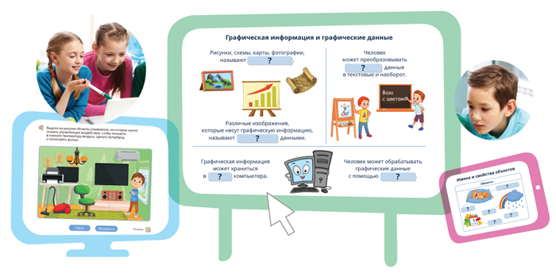
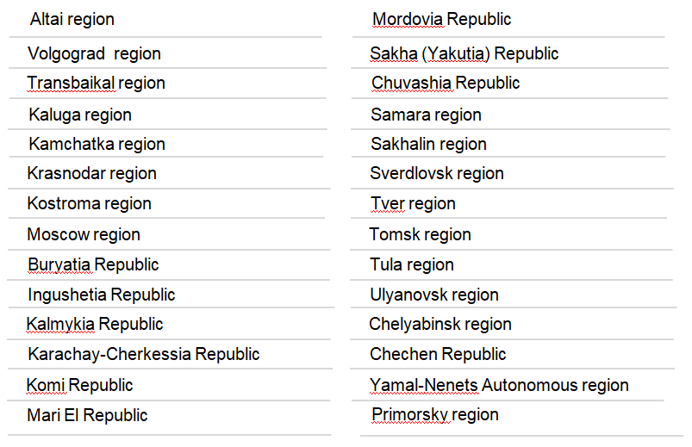
Who We Are
A Group of Companies focused on Holistic Digital Education Solutions
Education Segments: Pre-School, Primary & Secondary, Vocational, Higher & Corporate
The Solution Components: Multimedia Interactive Learning Content, Education Management Information Systems (EMIS), E-Systems for Teacher Professional Development, Digital (Blockchain-based) Documents, etc.
28+ Years of Experience, 300+ Employees, Offices in Moscow and Samara
Customers: Federal Ministries of Education, Culture, Interior + 67 Regional Education Authorities + >20K Schools + >200 Companies
Projects: Russian Electronic School, National Project “Education”, Advanced Training Centers, Road Traffic Safety for Children, etc.
Users: >18M people using our solutions, >1M on a daily basis

Slide 3
The Main Problem We Solve: Systemic Approach to Digital Education – 3 Key Pillars
Education Management Information Systems
Digital Multimedia Interactive Learning Content
Electronic Systems of Teacher Professional Development
Modular structure (specific modules can be selected based on particular requirements).
Single (one-time) entry of primary data.
Regional Digital Education Environment Core– repository of master data.
Multi-role user model.
Integration with e-Government services portal.
Integration with existing and new systems and services.
Coverage of all levels of education.
Developed by professionals and for professional use.
Atomized – structured into tiny units.
Lesson designer (constructor).
Gamification – for the greater students engagement into learning process.
Educational and learning collaboration.
Individual learning trajectories.
Adapted for all types of devices (PC, tablet, phone, interactive board, etc.).
Online and offline versions with the same functionality.
Access to constant and ongoing teachers professional development.
Teachers, principals and administrators practical engagement into modern Digital Education Environment.
Realization of entire business process as it is established in the region
Personalized professional development for each teacher based on building their individual Profile of Competencies.
Electronic (block-chain based) certificate of professional development

Slide 4
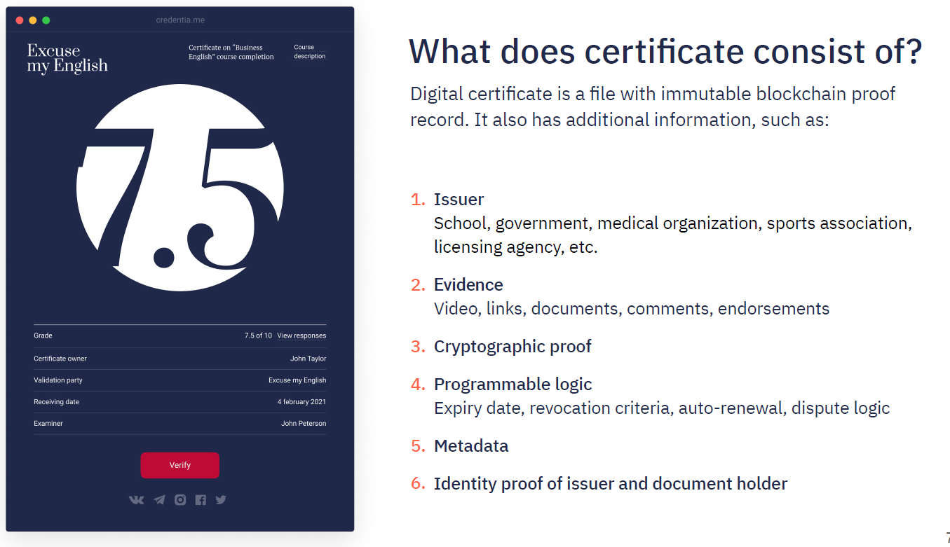
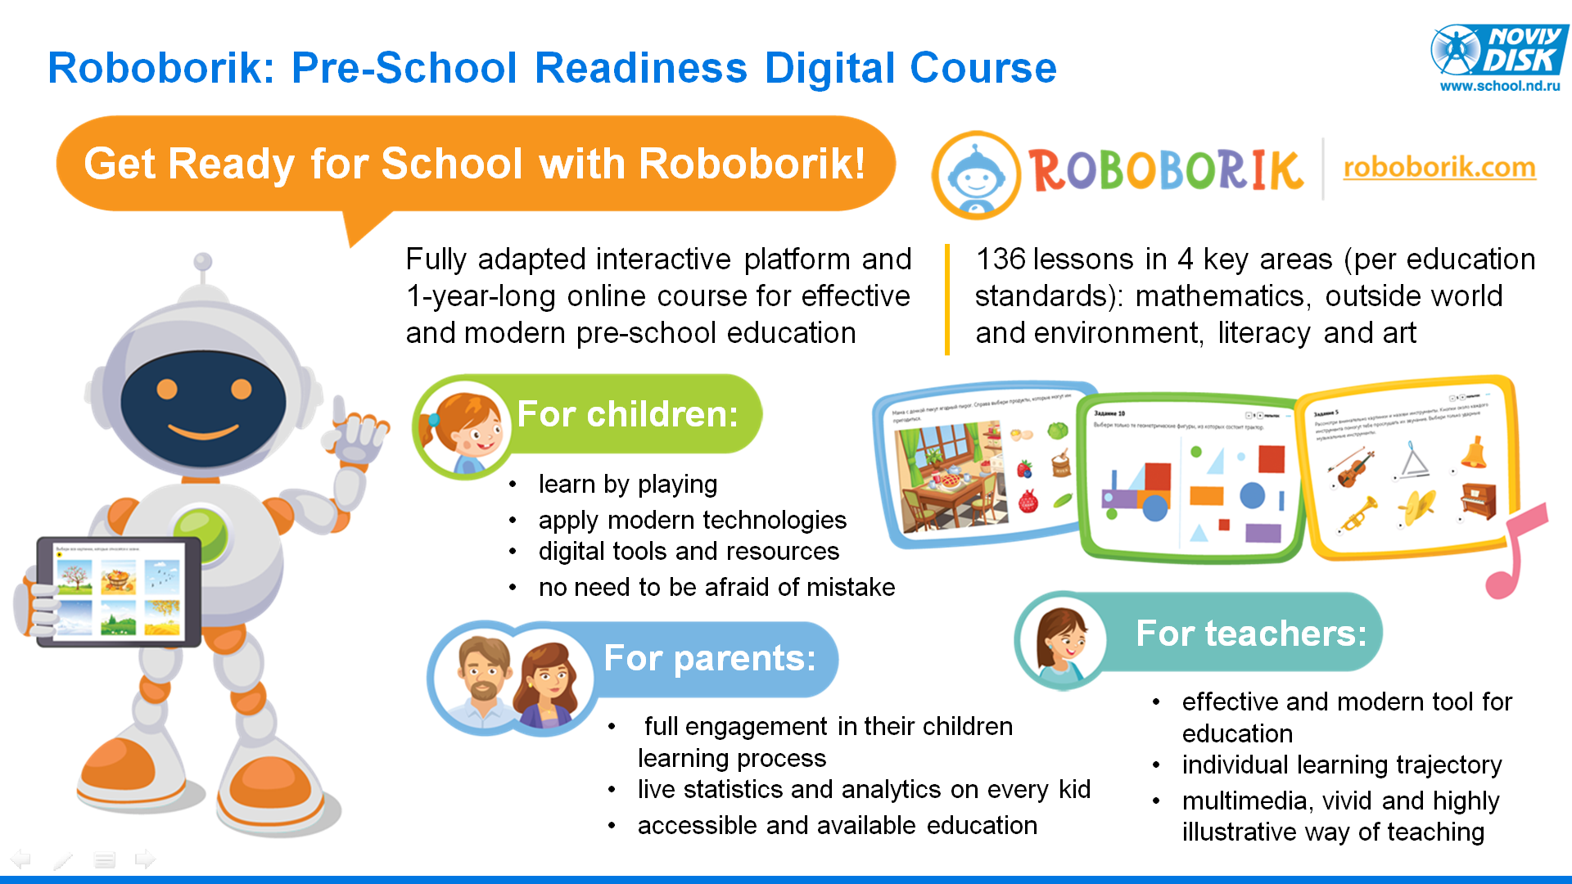
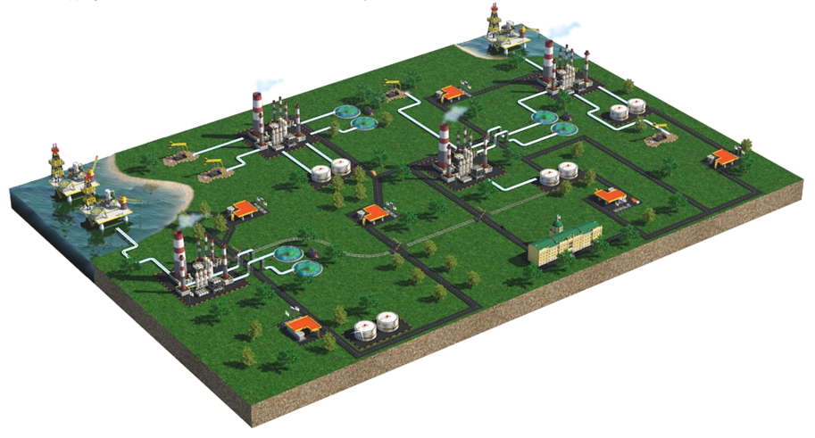
The Main Problem We Solve: Digital Learning Methodological Complexes & Credentials

Slide 5
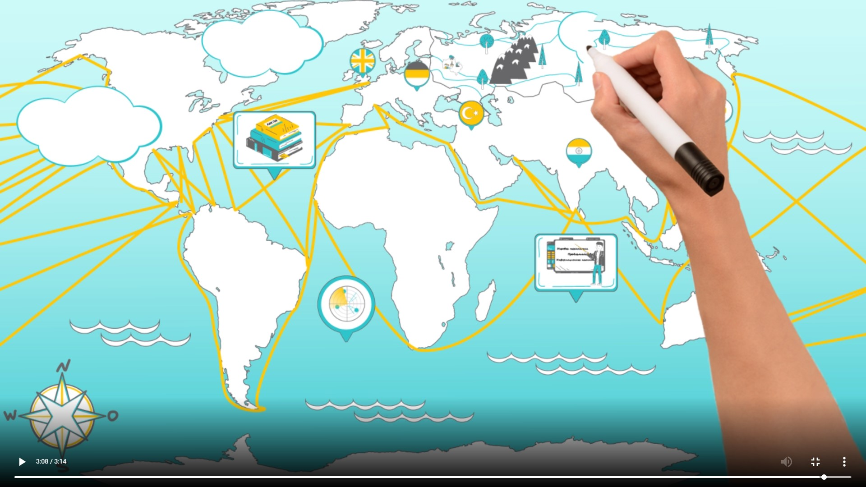
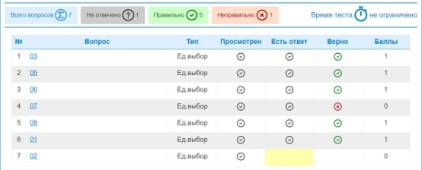
Customer Case and Its Results: E-System for Teacher Prof Dev in Moscow Region
1
>90K teachers went through the professional development training programs in a systemic and structured way – without the need to physically attend the classroom training sessions on site
Streamlined processes enabled to save >$2,5M in training organizational costs, travel and accommodation as well as efficiencies from system integration
44 continuing education courses, more than 400 training modules and micro modules for more than 6,000 training hours
A structured presentation of information using diagrams, infograhics and illustrations
Recommendations of modules based on the results of competency assessment and intermediate testing
Final testing at the course with the preservation of learning outcomes
Ability to adjust the content for the curriculum of the EPD
Electronic certificate of professional development

Slide 6
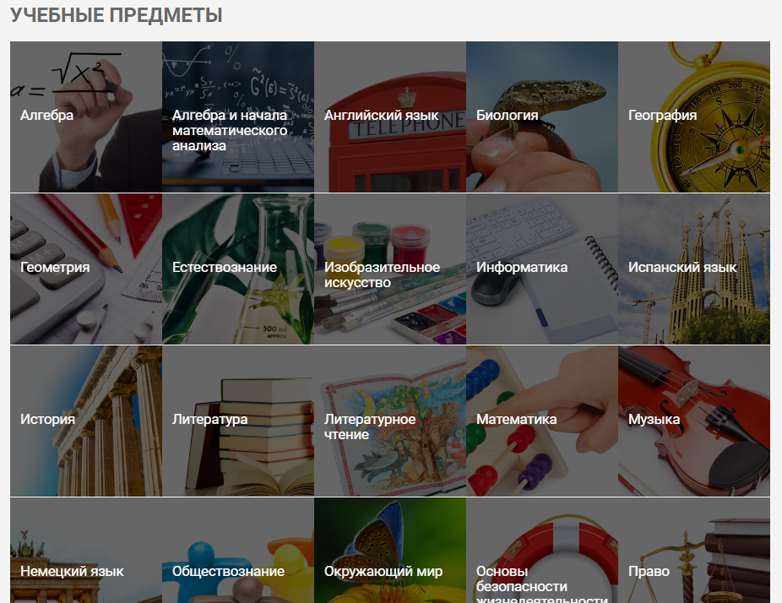
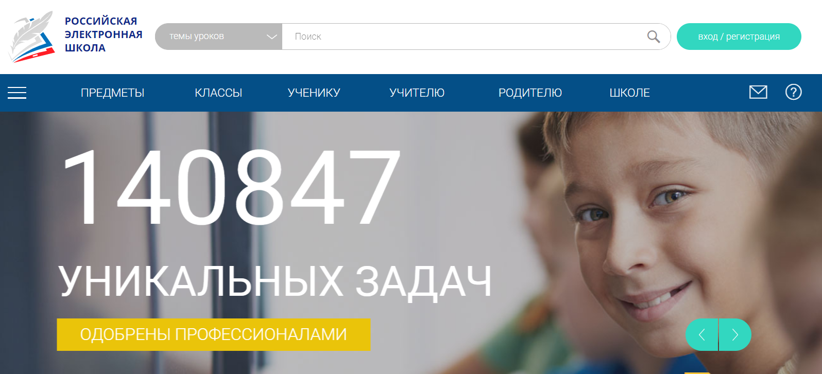
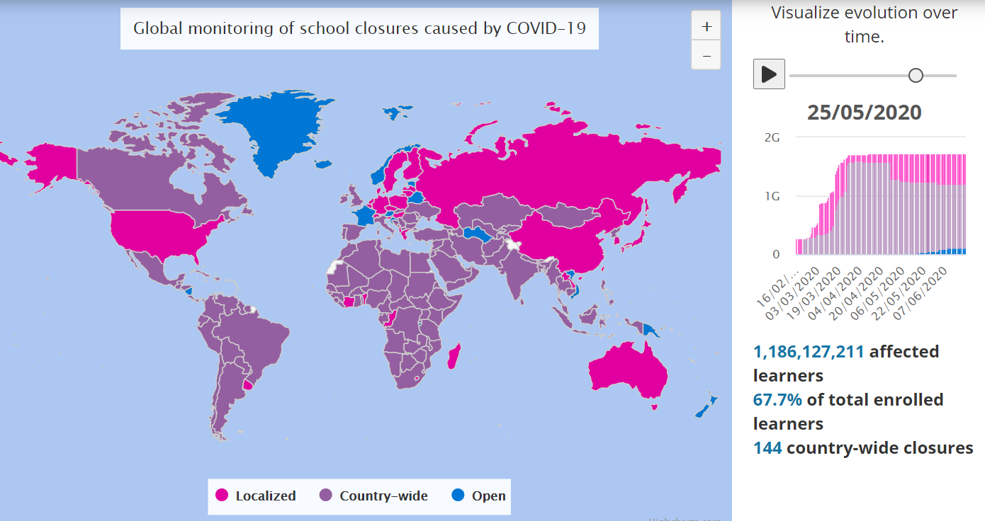
Customer Case and Its Results: Russian Electronic School in All 85 Russia Regions
1
A collection of digital multimedia interactive content for all National Russia Curriculum subjects (such as math, physics, geography, biology, etc.) from 1st through 11th grade
The country-wide tool that allowed for comprehensive, systemic and thorough digital education in all Russian schools, including assignments, knowledge check and control modules
Became highly instrumental and valuable during the quarantine and school closure conditions, as all teachers and students could continue the education process in electronic form

Slide 7
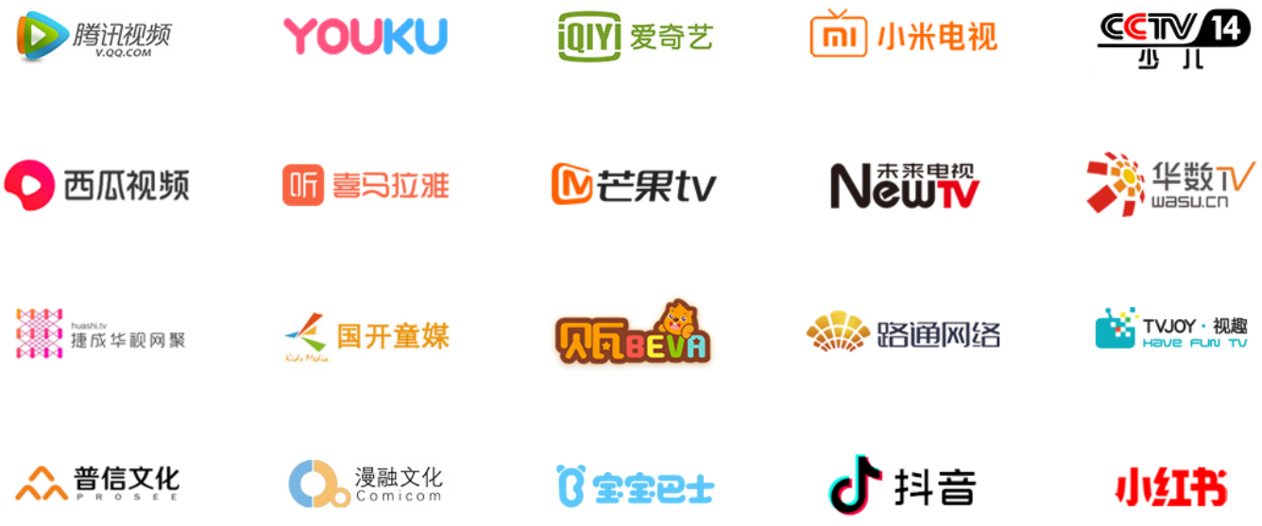
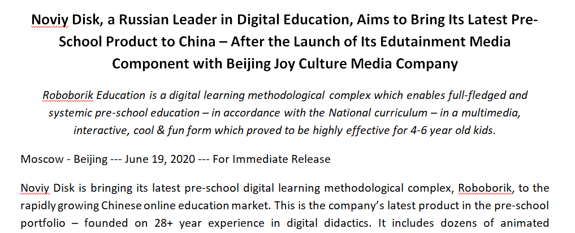
Customer Case and Its Results: Roboborik Pre-School Digital Education Complex in China
1
Roboborik Media component launched on >20 China’s leading digital video platforms
~1M views by Chinese children, parents, teachers and kindergarten adminstrators during the first 4 months
68 and growing number of edutainment animated cartoons to educate kids via digital didactics and methodology

Slide 8
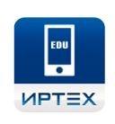
Key Elements That Made It Possible: Multi Modular Approach
Enrollment in GEO (general)
Enrollment in PSEO (pre-school)
Enrollment in OAE (additional)
Enrollment in PEO (professional)
Enrollment in children's health camps
Education in GEO
Education in PSEO
Education in OAE
Education in PEO
Regional (municipal)
government
education
Contingent
accounting
Multi-level system
education quality assessment
(with the ability to predict
results of the exam)
Monitoring
education systems
Regional
educational
testing system
Protection of
personal
data
Mobile app
"School diary"
Integration with federal systems
Integration with third-party information systems
Continuing education for
teachers and heads of educational organizations
Collection of
educational
of resources
Digital online
school
Online course for pre-school education ”Get Ready for School with Roboborik!”
Teachers’
Certification
Notes:
ФП «Цифровая образовательная среда» НП «Образование»
ФП «Цифровое государственное управление» НП «Цифровая экономика Российской Федерации»

Slide 9
Key Competitive Advantage: One Systemic Solution based on ND’s Modules
Monitoring the educational system
Enrollment in EO
Education Quality Assessment
GEO, PSEO , OAE , PEO
Improving the quality of education
Assistance in making management decisions
Electronic system
interactions
Core
Regional
DEE
Professional
educational content
(school, regional,
federal)
Integration with
interdepartmental services
Federal informational service platform DEE
Third Party Developments
Master Data Warehouse
Integration with public services
End-to-end integration
Electronic diary,
Electronic journal
Testing system
Module N
Lessons’
constructor
Electronic continuing education
Electronic Certification of teachers
Choosing a module according to customer needs
Unified Identification and Authentication System
Administration
Parents
Teacher
Student
Use of any devices: computer, laptop, tablet, smart phone, interactive whiteboard
Notes:
ФП «Цифровая образовательная среда» НП «Образование»
ФП «Цифровое государственное управление» НП «Цифровая экономика Российской Федерации»

Slide 10
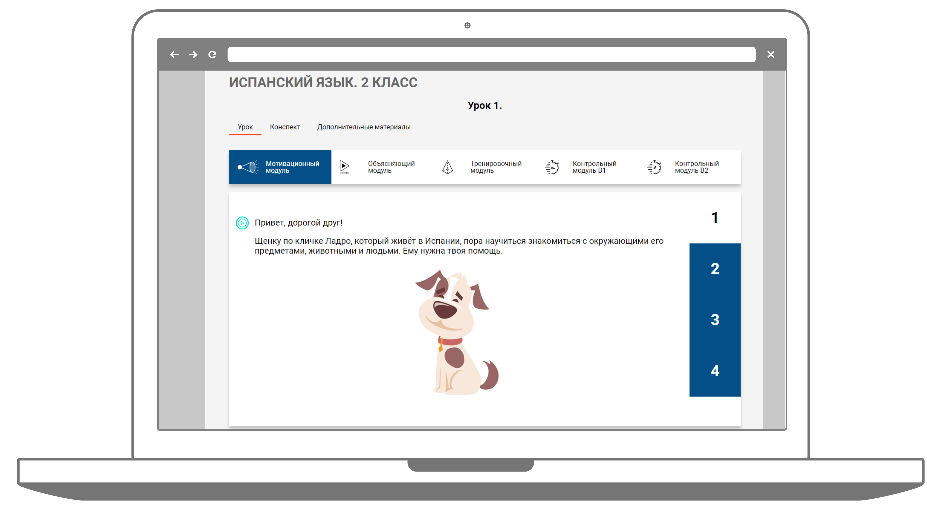
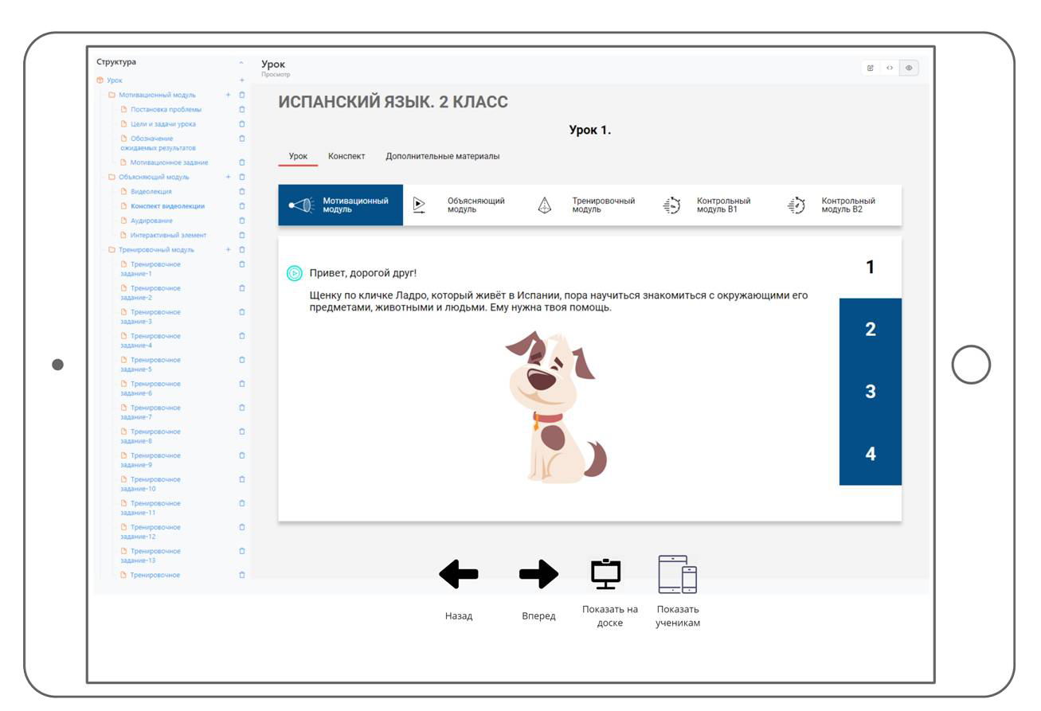
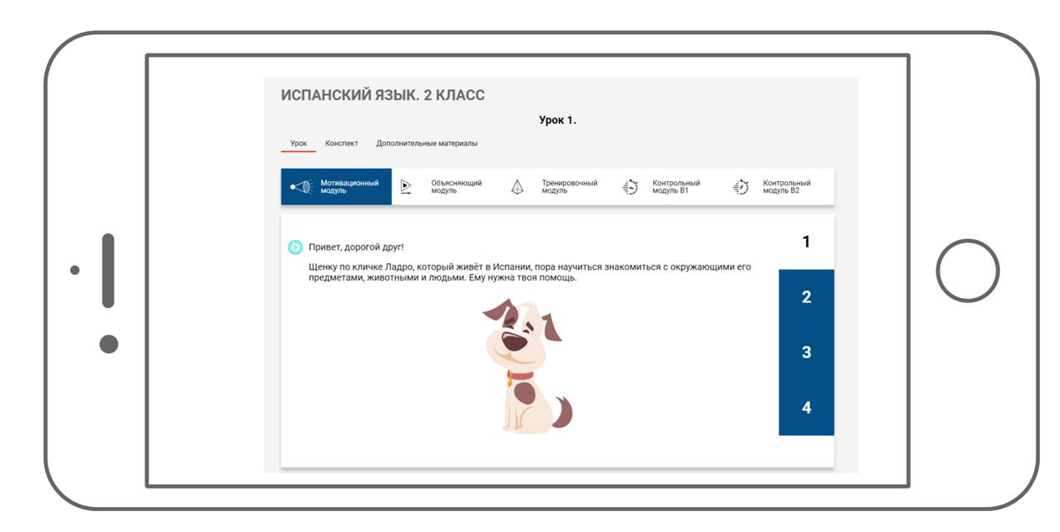
What It Will Take to Implement the Solution: One Core – Multiple Interfaces
The solutions that proved to effectively educate children over the last 28+ years
Holistic and systemic approach that ensure quality and sustainability
Availability on different types of devices and platforms, in online and offline modes
Notes:
ФП «Цифровая образовательная среда» НП «Образование»
ФП «Кадры для цифровой экономики» НП «Цифровая экономика Российской Федерации»

Slide 11
Thank You for Your Attention
Maxim Shirokov
m.shirokov@nd.ru
+7.903.797.1863

